Slide 1
Collaborating with GitHub

Slide 2
Working Solo
GitHub
Download repo
Change files, make commits
Push commits
push
clone
commit
commit
commit
my
machine

Slide 3
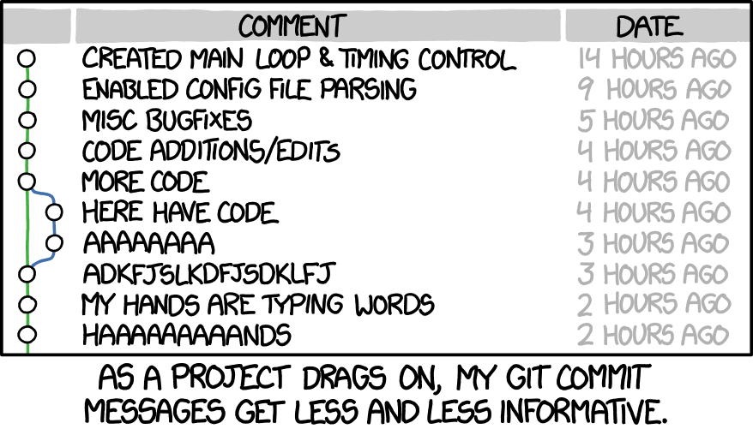
https://xkcd.com/1296/

Slide 4
Collaborating
(smoothly)
GitHub
Download repo
Change files, make commits
Push commits
Pull new commits
push
pull
clone
clone
commit
paul’s
machine
my
machine
chester’s
machine

Slide 5
demo

Slide 6
Practice: Collaborating (smoothly)
Player 1
Clone repo to your machine
Create new text file called README.md
Add project name and your name to file
Commit changes
Push to GitHub
Player 2
Clone repo to your machine
Add your name to file
Commit changes
Push to GitHub
Player 1
Pull commits
Player 3
Repeat steps 2

Slide 7
Collaborating
(not so smoothly)
GitHub
Paul commits
Chester commits
Chester pushes
Paul pulls
pull
commit
push
commit
paul’s
machine
my
machine
chester’s
machine

Slide 9
demo

Slide 10
Practice: Collaborating (not so smoothly)
<<<<<<< HEAD
My content
=======
Their content
>>>>>>> 6324500bb30bf7104fbedf29ddbe6bee668c1d40

Slide 11
Collaborating
(more smoothly)
GitHub
Paul pulls
Paul resolves merge conflict
Paul commits
Paul pushes
pull
push
commit
paul’s
machine
my
machine
chester’s
machine

Slide 12
Practice: Collaborating (not so smoothly)
Player 2
Add a one sentence description of your project to README.md
Commit changes
Push to GitHub
Player 1
Add a different one sentence description of your project to README.md
Commit changes
Pull player 2’s commit
Resolve merge conflict by editing README.md
Commit changes
Push to Github
Player 3
Repeat steps 2

Slide 13
Assignment for Monday
Create a beautiful README.md
Project description
Project timeline
Make issues for first to-do items

Slide 14
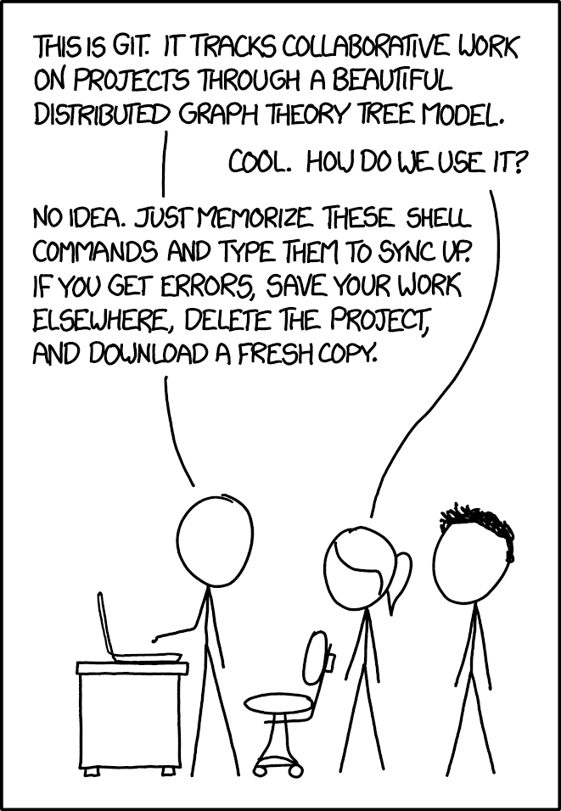
https://xkcd.com/1597/

